Slide 1

Barrier Reef Orchestra Flow Chart
Home
Welcome to Barrier Reef Orchestra (BRO)
Artists &
Events
List of Events for 2017
Events Featuring an Artist
Artist Profiles
Featured Artist
About Us
North Queensland Ensembles Inc.
Goals of the BRO
History of BRO
BRO Committee
Past Events
Support Us
Registration Form
– Members
– Players
– Benefactor
List of Benefactors
List of Sponsors
Contact Us
Address, Phone & Email Details
Link to Facebook Pages
Send a Message
Acknowledgements

Slide 2

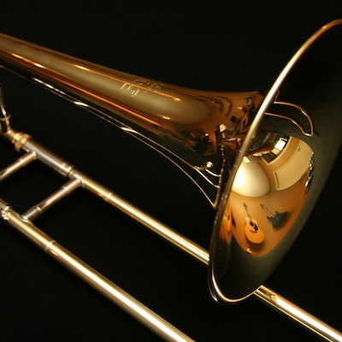
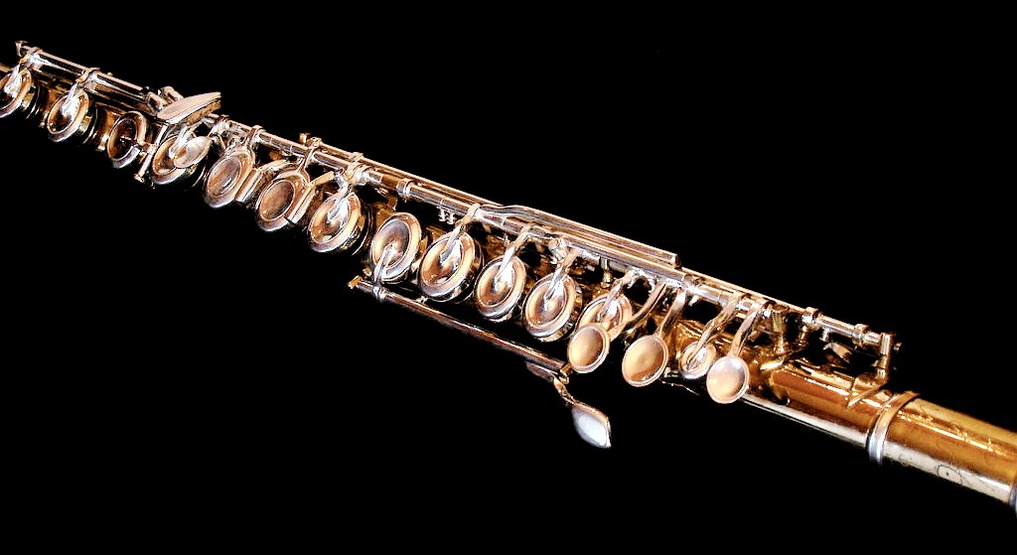
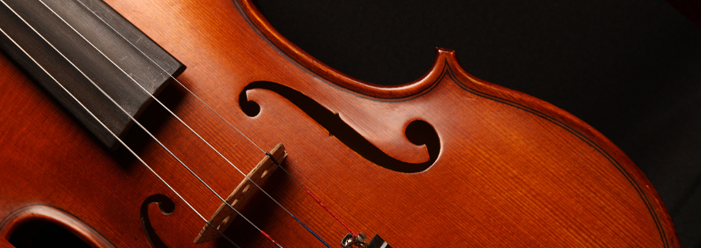




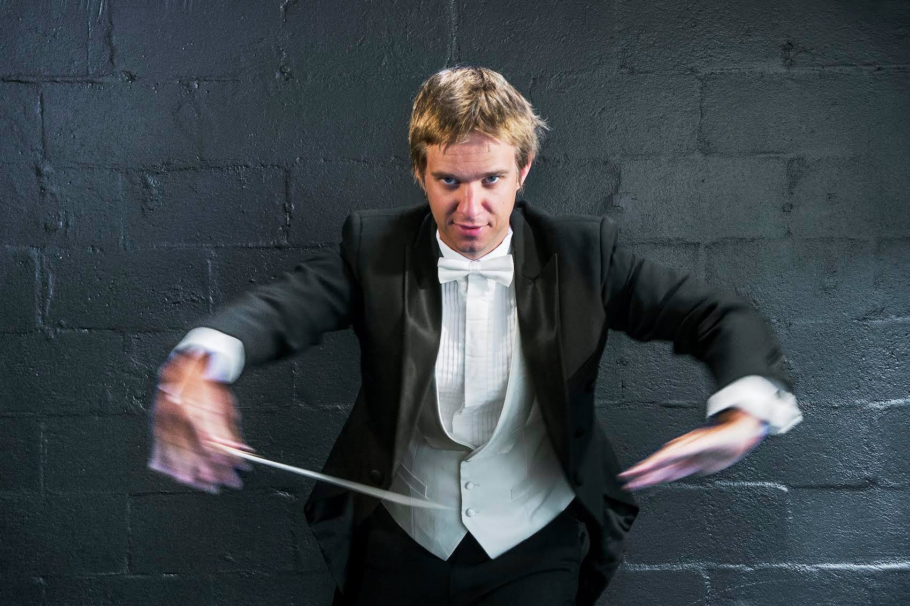

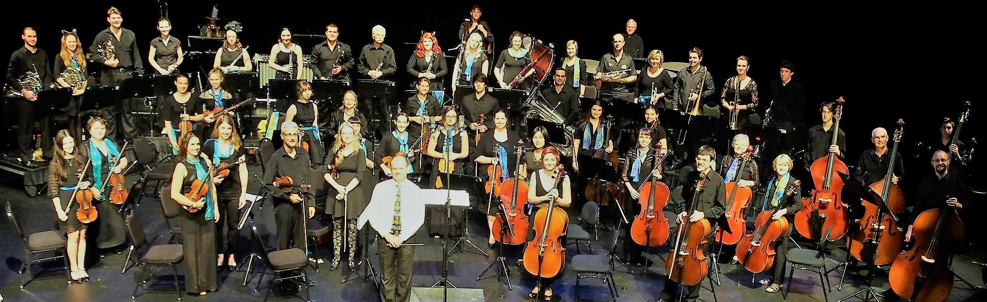






Barrier Reef Orchestra
Search
Home
Artists & Events
About Us
Support Us
Contact Us
Email Us
brotownsville@gmail.com
Barrier Reef Orchestra
Barrier Reef Orchestra
Players
Barrier Reef Orchestra
PO Box 576
Townsville Qld 4810
p: +61 (0) 747 222 789
Highlights
Since the early nineties people and groups have contributed to the orchestra's growth and development.
The orchestra is recognised as a significant contributor to the
promotion of music in North Queensland.
Local and international talent contact us to perform at our events.
Annual performances include:
The highly acclaimed Australian Concert Vocal Competition
Orpheus Strings
Pandanus Winds
Kingfisher Trio
The Centenary Concert
Major Sponsor Sponsors Concert Partners

Slide 3
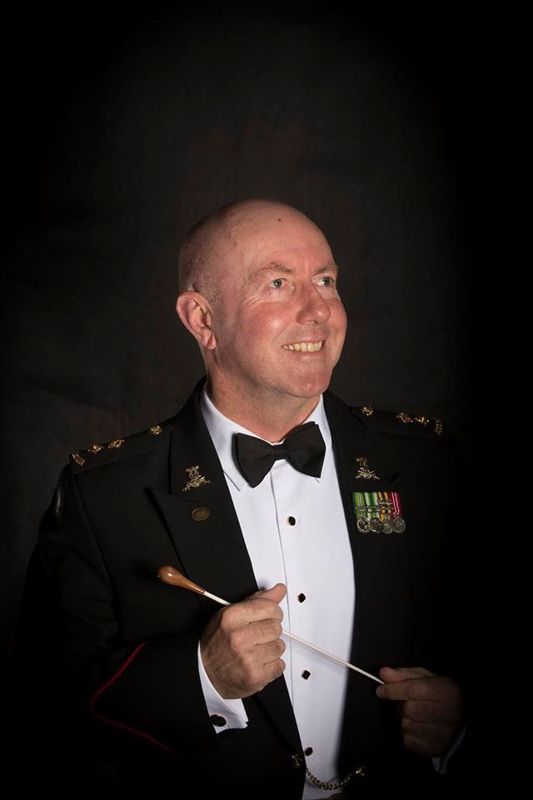
Barrier Reef Orchestra
Search
Home
Artists & Events
About Us
Support Us
Contact Us
Email Us
brotownsville@gmail.com
Barrier Reef Orchestra
Barrier Reef Orchestra
Players
Barrier Reef Orchestra
PO Box 576
Townsville Qld 4810
p: +61 (0) 747 222 789
About Us
The Barrier Reef Orchestra is a product of North Queensland Ensembles Inc which is an Incorporated Association registered in the State of Queensland.
In a typical year the Barrier Reef Orchestra performs three times generally with a guest conductor and occasionally with other performing groups. Smaller ensembles, all utilising players from the Orchestra, regularly give concerts.
The advancement of the Barrier Reef Orchestra has been profound over the years:
+2006 +2007 +2008 +2009 +2010 +2011 +2012 +2013
+2014 +2015 +2016
Major Sponsor Sponsors Concert Partners

Slide 4
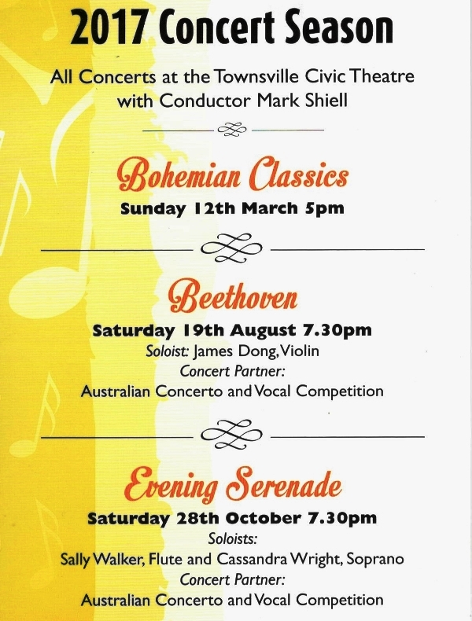


Barrier Reef Orchestra
Search
Home
Artists & Events
About Us
Support Us
Contact Us
Email Us
brotownsville@gmail.com
Barrier Reef Orchestra
Barrier Reef Orchestra
Players
Barrier Reef Orchestra
PO Box 576
Townsville Qld 4810
p: +61 (0) 747 222 789
Our contact details are:
Phone: +61 (0) 747 222 789
Email: brotownsville@gmail.com
Facebook Pages: Barrier Reef Orchestra
Barrier Reef Orchestra Players
Postal Address: Barrier Reef Orchestra
PO Box 576
Townsville Qld 4810
Major Sponsor Sponsors Concert Partners

